Slide 1
Autonomous Flag Finder
Burnout Squad
Jeremiah McCutcheon: Project Manager
David Koblah: Hardware Design
Michael Bates: Software Design

Slide 2
System Description
This system is an autonomous robot designed to locate, identify and retrieve flags inside a room or maze.
It will utilize a camera and proximity sensors to navigate its environment.
The camera will wirelessly communicate with a computer in order to identify flags and retrieve them.
A microcontroller will control the movement of the tank, proximity sensors and servo motors to rotate the camera or retrieve the flags.
Jeremiah McCutcheon

Slide 3
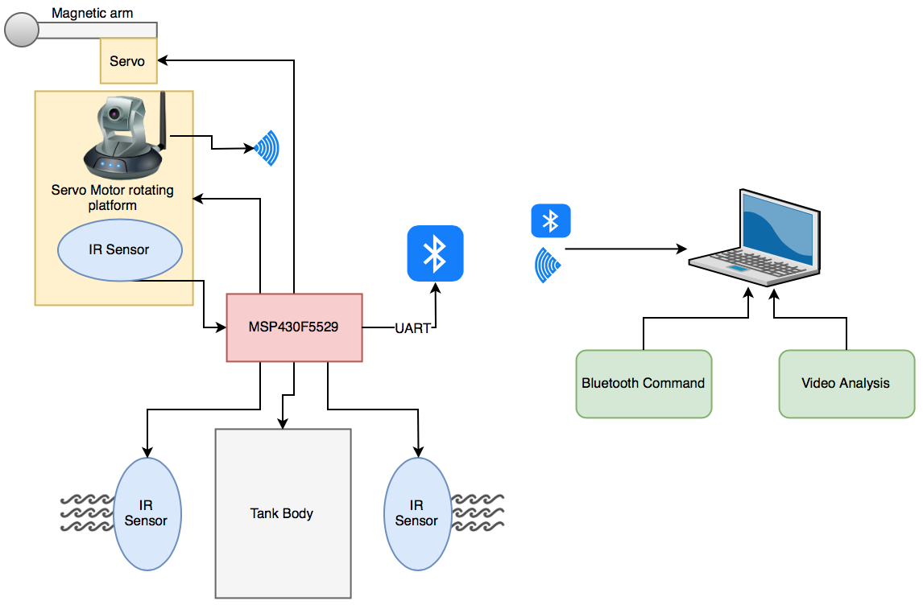
System Diagram
David Koblah

Slide 4
Division of labor
Jeremiah: Camera research, system concept development, and locating parts
David: Microcontroller research, initial hardware design, and H-Bridge
Michael: Sensor research, wireless communication research, and retrieving parts
Jeremiah McCutcheon

Slide 5
Safety Concerns
The items we have procured so far needed to be checked for near-optimum condition. That included:
Scoping ports and pins for digital and analog signals.
Managing wiring and cables to prevent short circuits and loose wiring.
Using appropriate voltages and currents for test functionality
We will face issues as we dig into the assembling of our system.
David Koblah

Slide 6
This Week’s Deliverables
Planning Phase
Determine a basic system overview ✅
Determine what components are needed ✅
Determine best ways to interface components ✅
Determine Project Flow and Milestones ✅
Assign Division of Labor ✅
Determine/Create a GANTT Chart and Budget ✅
Research Components ✅
Michael Bates

Slide 7
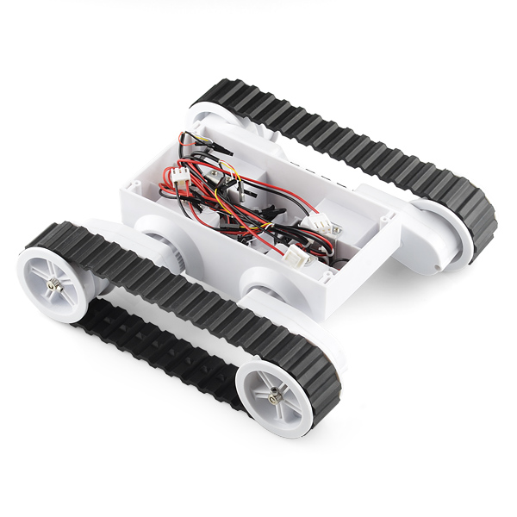
Rover 5 Robot Platform
Jeremiah McCutcheon
SparkFun: Rover 5 Robot Platform [1]

Slide 8
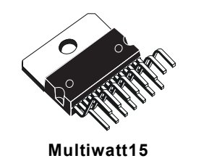
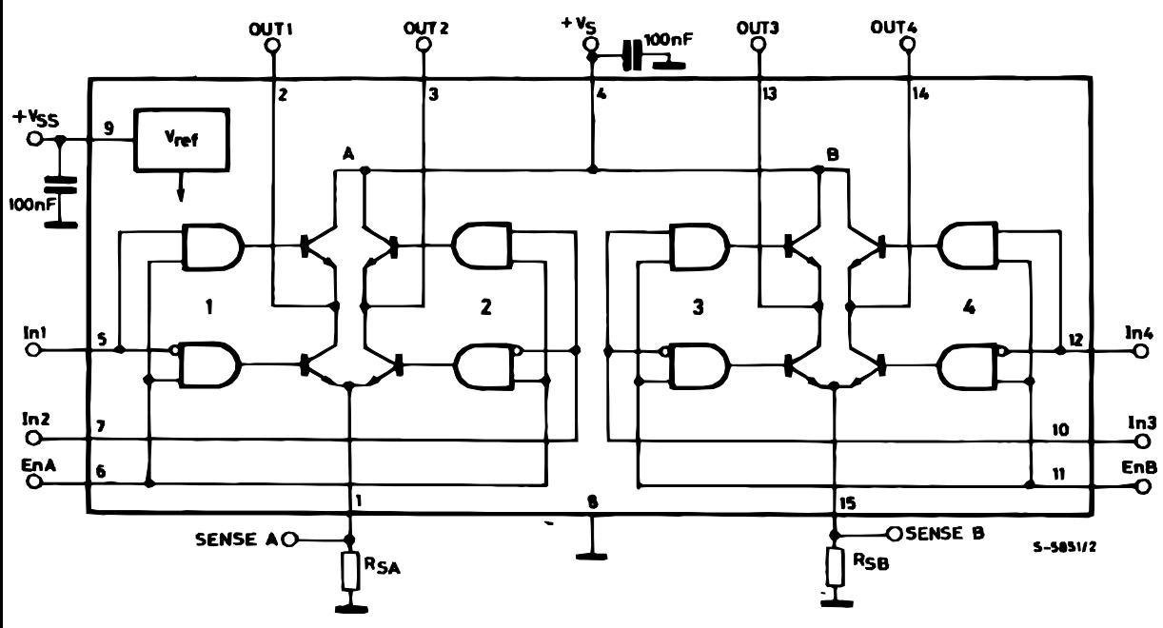
H-Bridge
Enable A: controls the Right track
Enable B: controls the Left track
In 1: Right track forward
In 2: Right track reverse
In 3: Left track forward
In 4: Left track reverse
Jeremiah McCutcheon
ST Microelectronics: Dual Full Bridge Driver [2]

Slide 9
Flags
Ball Bearing
Flag
Bluetooth Emitter
Jeremiah McCutcheon

Slide 10
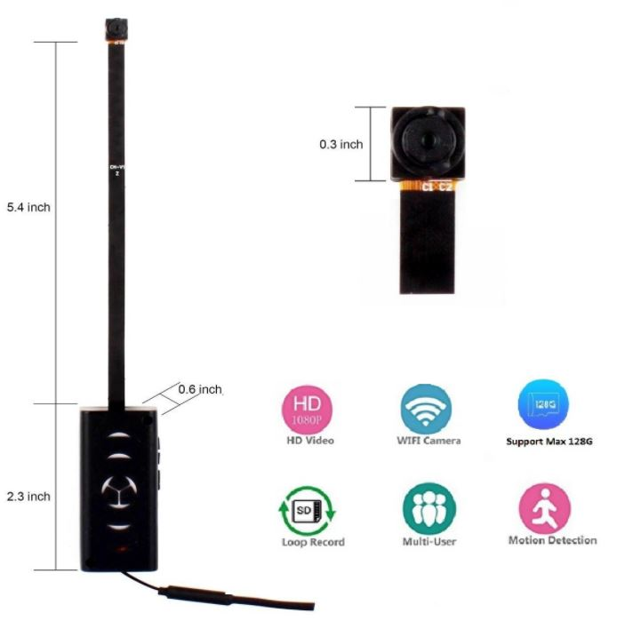
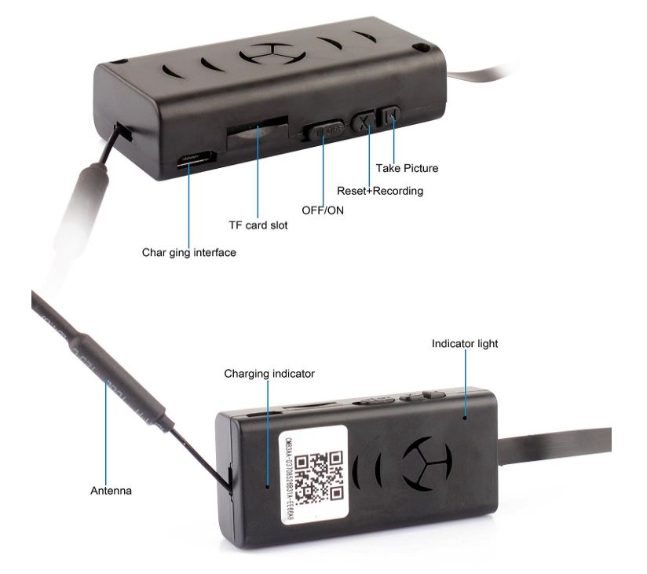
MAGENDARA WIFI Camera
Dimensions and Layout [3]
David Koblah

Slide 11
MAGENDARA WIFI Camera
Video Format: AVI
Video Coding: H.264
Video Resolution 1280x720 30fps
Cycle Record: Yes
Supports Max: Capacity 128GB
Battery Actual: Capacity 480 mAh
Item Weight: 0.8 ounces
David Koblah

Slide 12
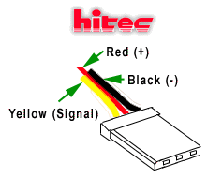
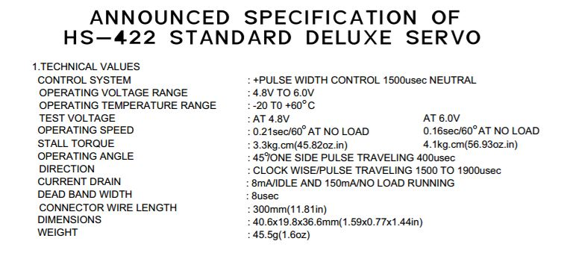
HS-422 Servo Motor
Yellow signal indicates signal cable for pulse
Ideal period of 20ms with pulse width between 1ms and 2ms. Angles used were approximately 0 degrees, 90 degrees and 180 degrees
Wiring Scheme [4]
Specifications [5]
David Koblah

Slide 13
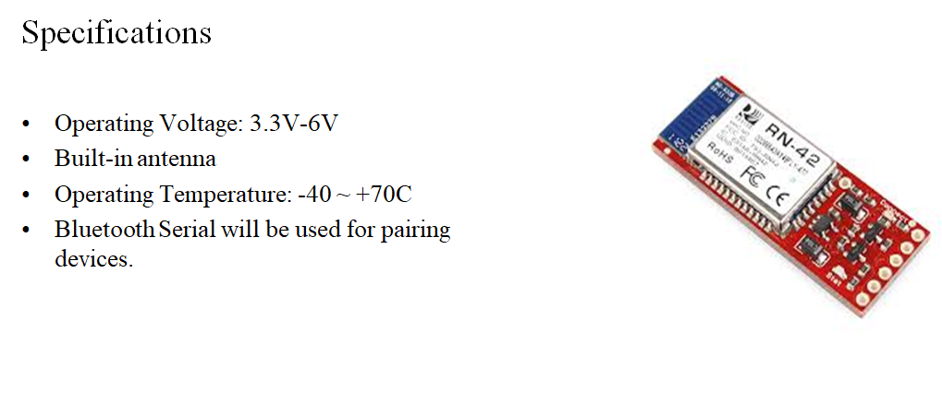
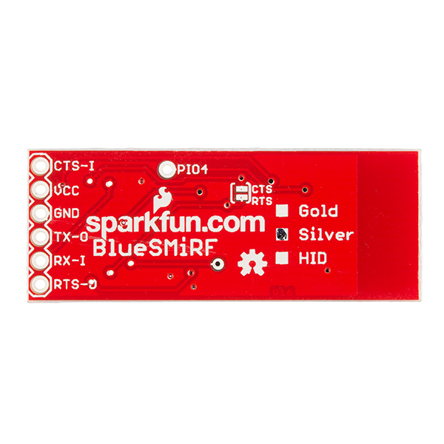
Bluetooth Smirf
Specifications [6]
David Koblah

Slide 14
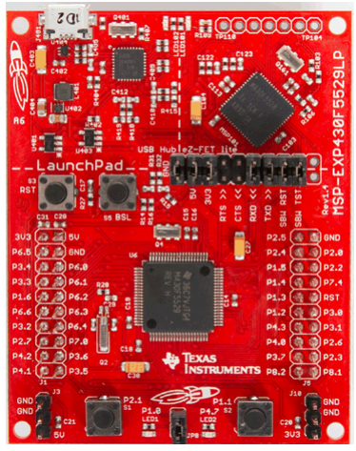
MSP430F5529
Launchpad [7]
Michael Bates

Slide 15
Advantages of F5529 vs G2553
128 kB Flash Memory vs 16 kB
8 kB RAM vs 512 bytes
40 Pins vs 20 I/O Pins
5 V and 3.3 V Rails vs 3.3 V Rail only
25 MHz System Clock vs 16 MHz System Clock
Michael Bates

Slide 16
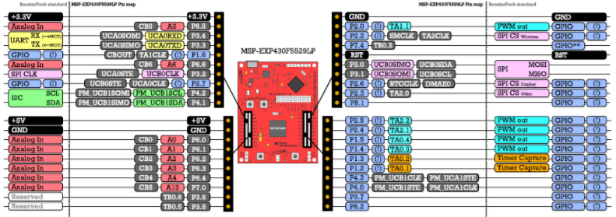
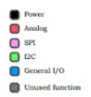
MSP430F5529 Pinout
Pinout Scheme [8]
Michael Bates

Slide 17
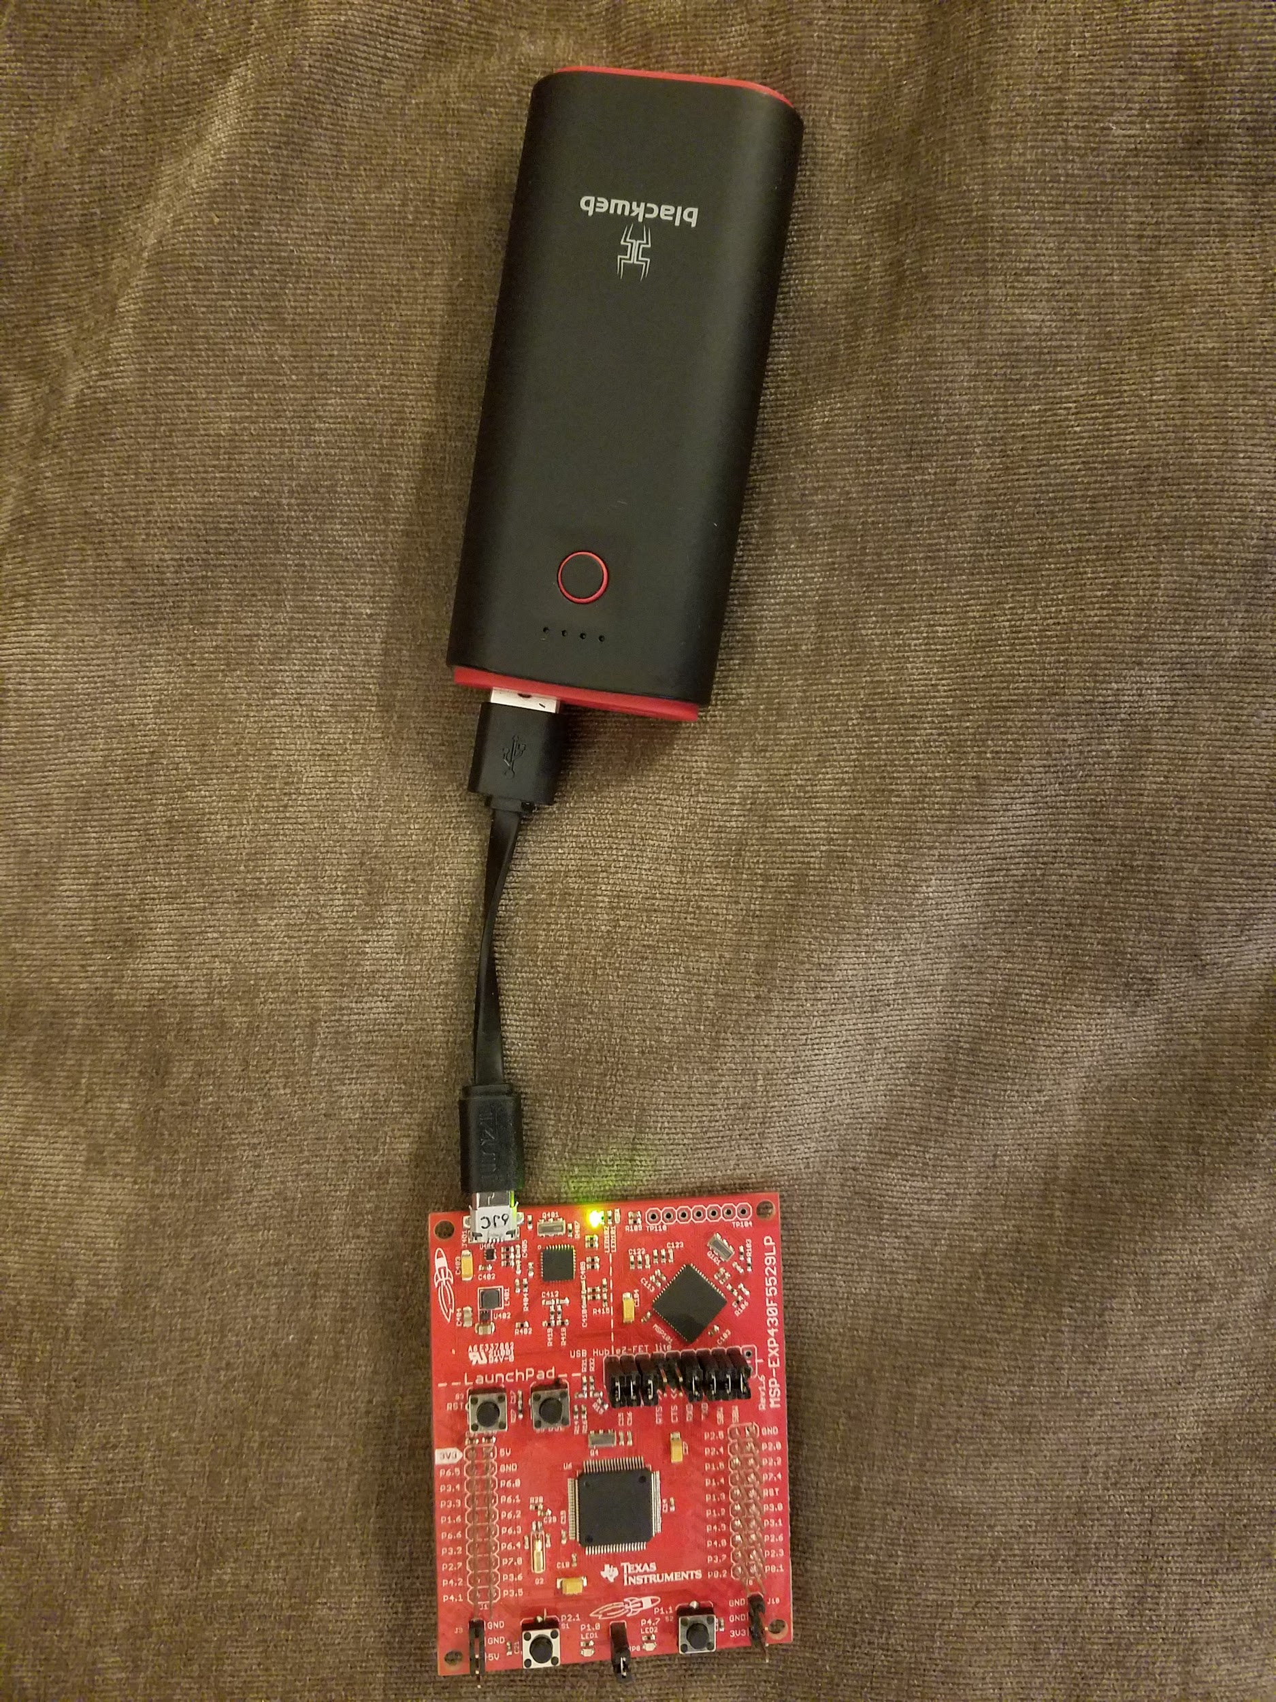
Powering the MSP430F5529
USB 2.1 A 5200 mAh Powerbank
Michael Bates

Slide 18
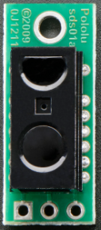
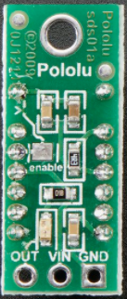
Pololu Carrier with Sharp GP2Y0D810Z0F Digital Distance Sensor
IR Sensors
GND VIN OUT
LED
Pinout and Sensor LED [9]
Michael Bates

Slide 19
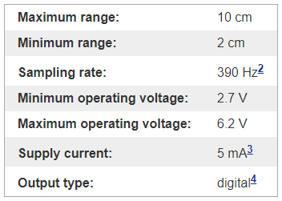
Pololu Carrier and Sharp Sensor Specs
Michael Bates
Technical Details [10]

Slide 20
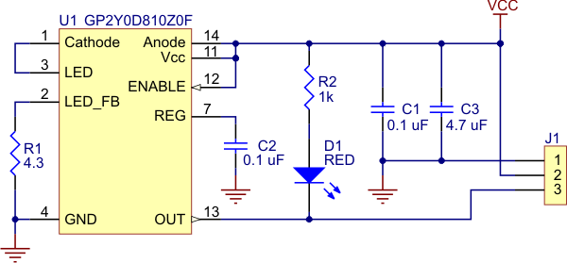
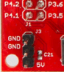
Pololu Carrier Schematic
Pololu Carrier [10]
Bottom Left Corner MSP430F5529 Eval Board
[7]
Michael Bates

Slide 21
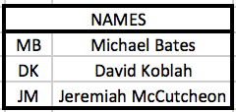
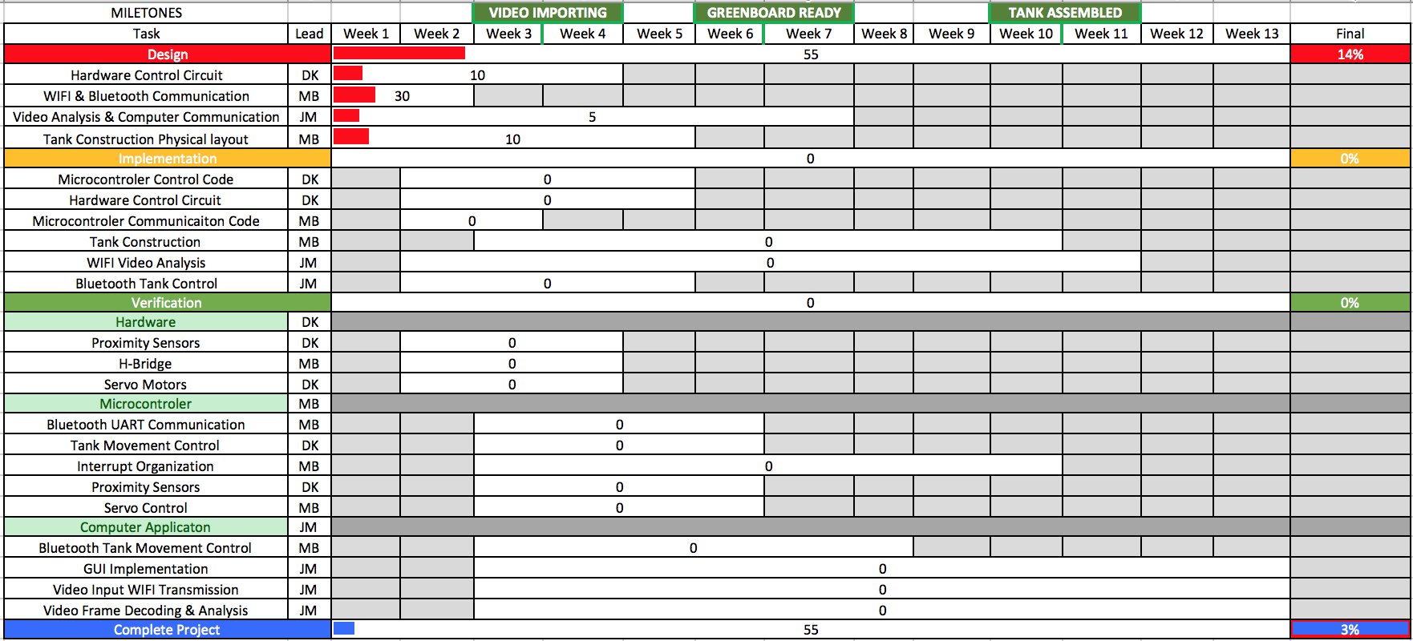
Gantt Chart
Jeremiah McCutcheon

Slide 22
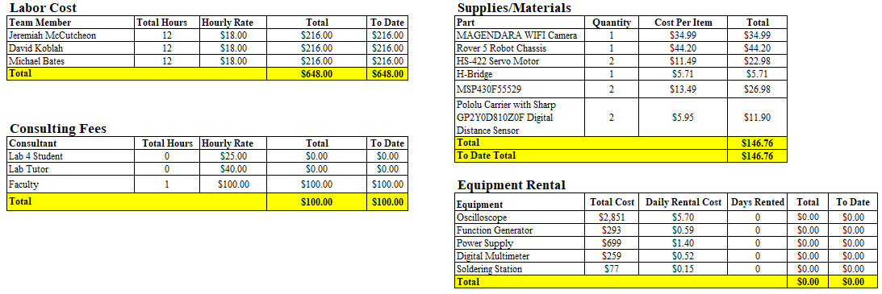
Budget
Michael Bates

Slide 23
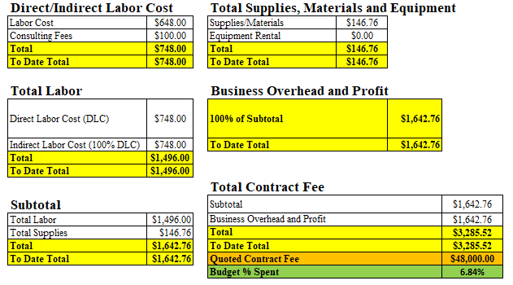
Budget Continued
Michael Bates

Slide 24
Next Week’s Deliverables
Jeremiah McCutcheon
Acquire IP camera and start configuring communication
Begin writing image processing code
David Koblah
Begin writing code for UART Bluetooth communication
Research integrating Bluetooth and IP communication into one UI
Michael Bates
Write skeleton code for MSP Board
Integrate sensors into system.
David Koblah

Slide 25
References
[1] Sparkfun Rover 5 Robot Platform, https://www.sparkfun.com/products/10336
[2] ST Microelectronics H-Bridge dual motor controller : http://www.st.com/en/motor-drivers/l298.html
[3] MAGENDARA WIFI Camera, Mini Wireless Camera 1080P Camera with Motion Detection, http://www.spygearco.net/shop/surveillance-cameras/hidden-cameras/magendara-wifi-camera-mini-wireless-camera-1080p-camera-with-motion-detection/
[4] Servo Wiring Information, Servos and How They Are Wired, http://www.fatlion.com/sailplanes/servos.html
[5] Announced Specification of HS-422 Standard Deluxe Servo, http://wcours.gel.ulaval.ca/2015/h/GEL3014/default/8fichiers/fichiers/Servo_HS422.pdf
[6] Sparkfun, Sparkfun Bluetooth Modem-BlueSMiRF Silver, https://www.sparkfun.com/products/12577
[7] Texas Instruments User’s Guide, MSP430F5529 Launchpad Development Kit, http://www.ti.com/lit/ug/slau533d/slau533d.pdf

Slide 26
References Continued
[8] File: MSP-EXP430F5529LP QSG PinOut.png, http://processors.wiki.ti.com/index.php/File:MSP-EXP430F5529LP_QSG_PinOut.png
[9] Adafruit, Sharp GP2Y0D810Z0F Digital Distance Sensor with Pololu Carrier, https://www.adafruit.com/product/1927
[10] Pololu Robotics and Electronics, Pololu Carrier with Sharp GP2Y0D810Z0F Digital Distance Sensor, https://www.pololu.com/product/1134/specs

Slide 27
Questions?

